Slide 1
Afferent feedback profile from muscle profile.
Ia feedback is the length of the series spring.
II feedback is the length of the parallel spring.
Ib feedback is the tension in the muscle.
Ia & II feedback is acquired by simulate run the leg with desired motion (in unit of cm). Ib feed back is from the Tension we calculated through the inverse kinematic process (in unit of N).
When inject the feedback into neurons of our control network, each feedback need multiply a gain parameters.

Slide 3
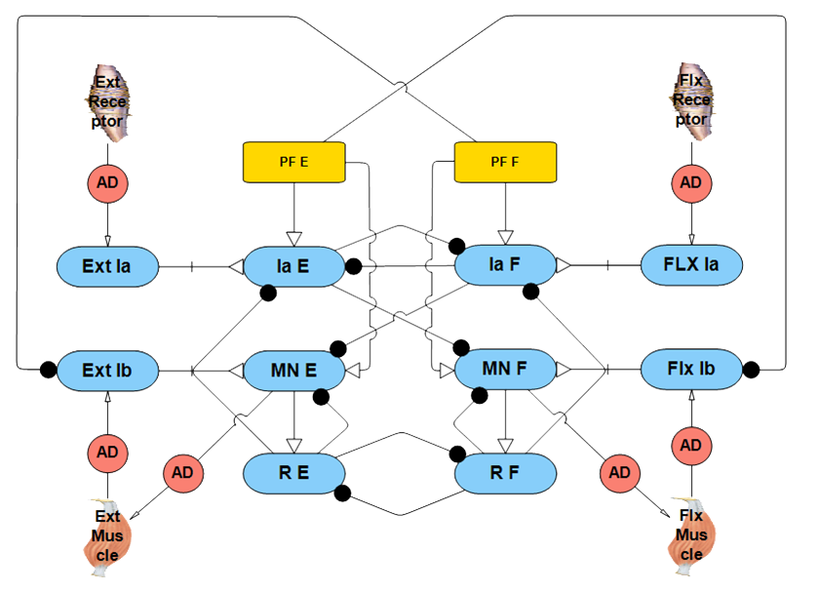
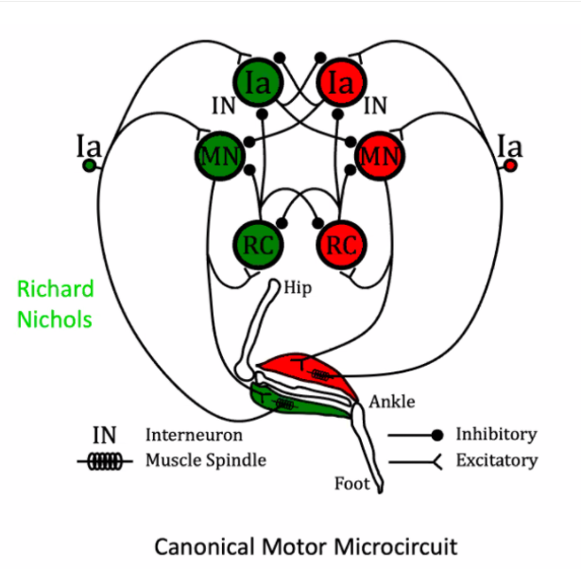
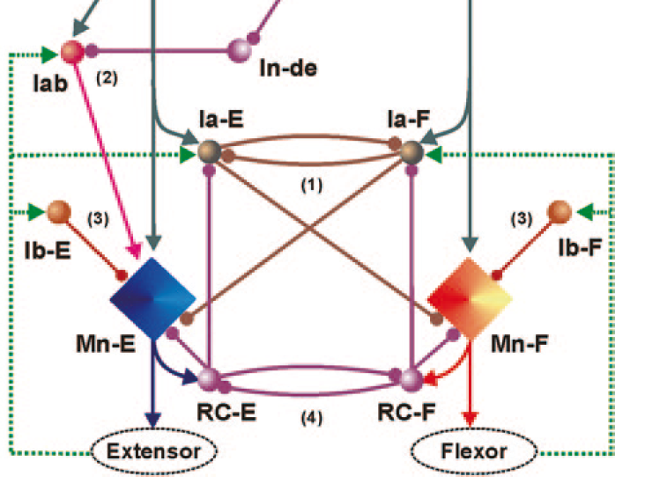
Design of motoneuron pool
Original Design
Dr. Heckman’s presentation
Rybak’s model
Cat’s reflex circuit
What we known and should retain:
The motoneuron pool that control the basic reflex circuits compose by a reciprocal inhibition of antagonistic motoneurons mediating via Ia inhibitory Interneurons, recurrent inhibition of motoneurons via Renshaw cells, non-reciprocal motoneuron inhibition/excitation Ib cells.
a pair of MN
a pair of Ib
(Not directly talk to each other)
a pair of Ia interneuron
a pair of Renshaw cell
(reciprocal inhibition, both inhibit MN)

Slide 4
Uncertain thing:
Ib inhibition/excitation?
Involving II feedbacks into the MN net
How to deal with multiple muscles in MN pools?
Trying out in the program
Ib feedbacks
Ib stands for tension in the muscle, logically it should be inhabitation connection to MN to prevent over shoot in generating active force. But in Alex’s model it excites the MN under the inhabitation of opposite PF neurons.
Still investigating in auto-gen codes.
II feedbacks
We used Hip II feedback in the CPGs to reciprocal inhibits the Ext/Flx magnitude, regulating the walking period.
The idea of involving II feedback into the MN network is too constantly checking if the body reach desired location.
By using differentiation subnetwork to find the error between desired muscle length and PE spring length (which is approximately the muscle length), if the muscle not reaching that length we give MN the error excitation to correct it .

Slide 5
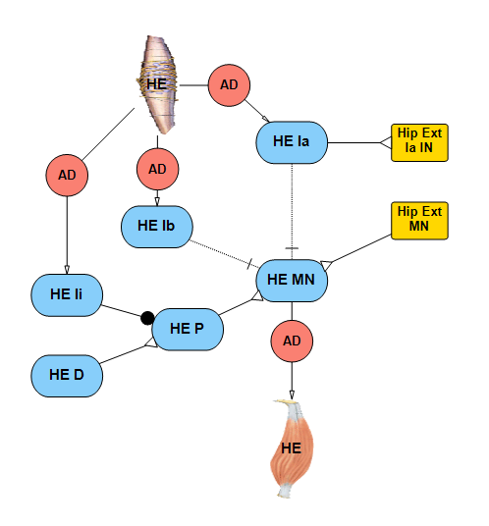
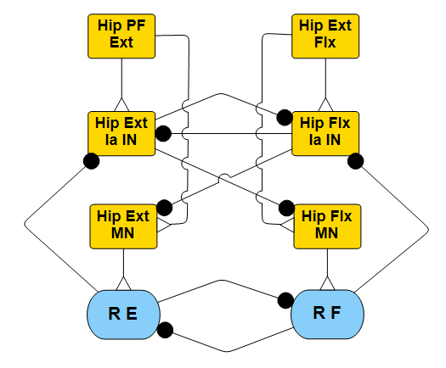
For antagonist's muscles, they reciprocal inhibit each other. But for multi-muscle, in one MN pool, things get a little tricky.
My thoughts are:
divide muscle base on functional pools, like ext/flex
each muscle's MN module still have it's own modular set up
muscle with same motion function share the same Ia in & RE cells
then the shared Ia & Re neuron reciprocal inhibit another sets of Ia & Re neurons with contrast motion function.

Slide 6

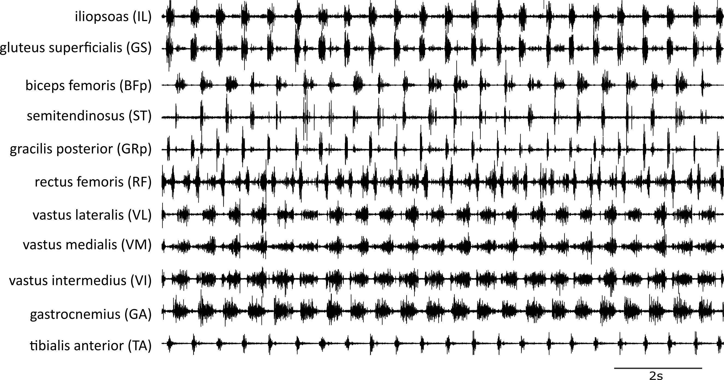
How we use EMG data
Hip Flexor
Hip Extensor
Hip Flexor Knee Extensor
Knee Extensor (?)
Knee Flexor Ankle Extensor
Ankle Flexor
From Matthew Tresch lab

Slide 7
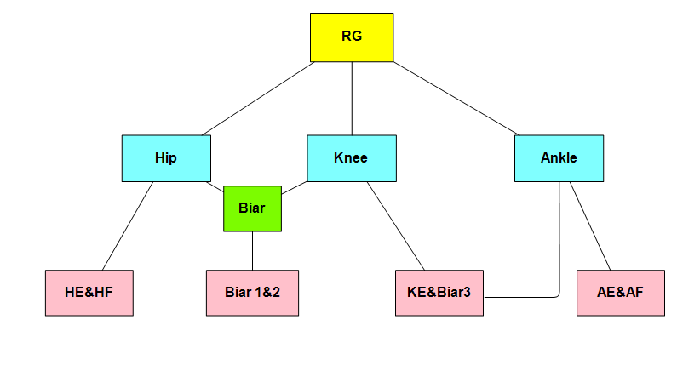
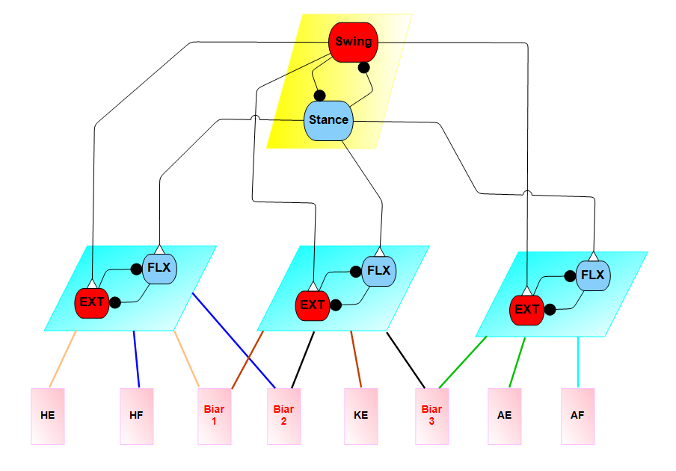
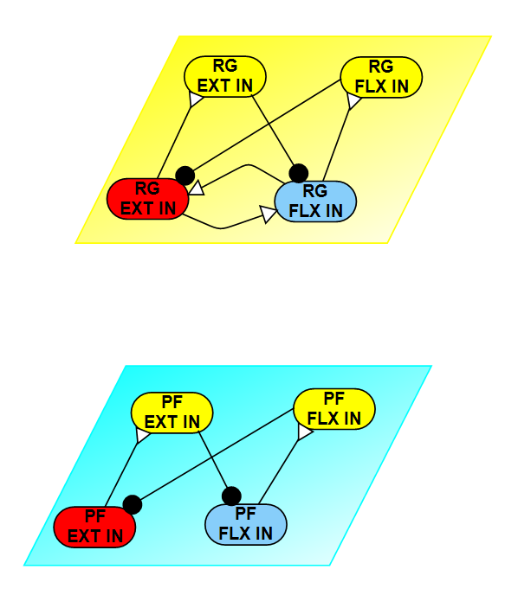
Neural Network
RG
PF
MN
Notes:
Ia SE length (Length and velocity of muscle)
Ib tension in muscle
II PE length

Slide 8
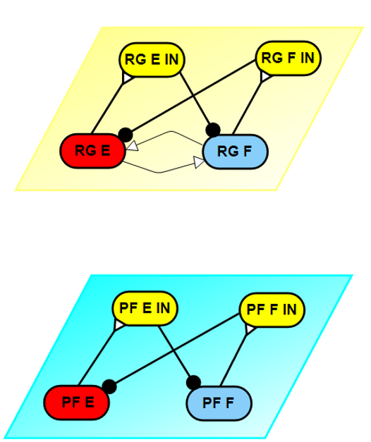
A.
C.
D.
B.

